Slide 1
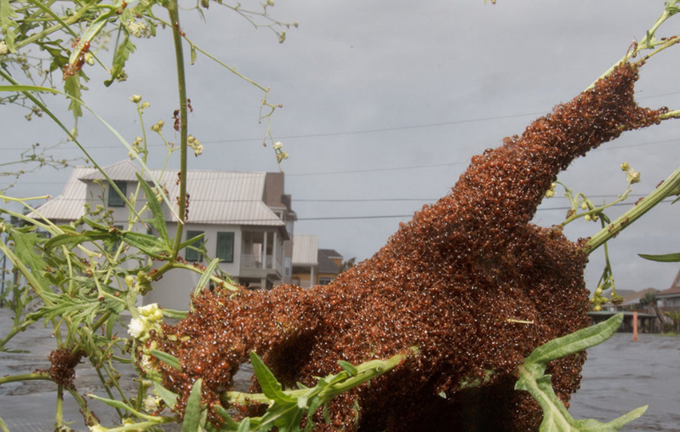
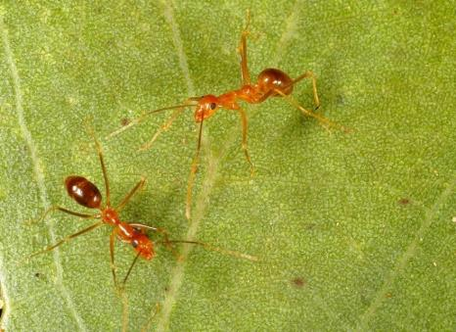
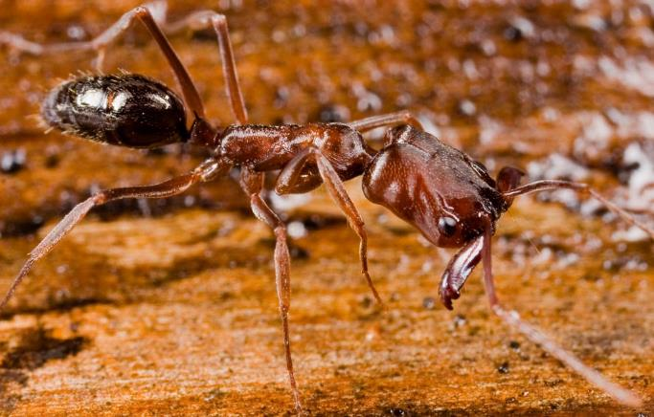
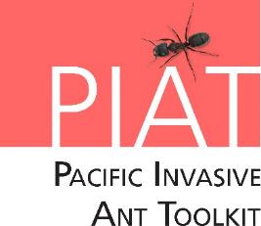


PIAT Lesson with ants and ladder game
Notes:
Credits: Left to right: © Matthew Hinton (http://photos.nola.com/nolacom_photo_essays/2011/09/photographers_lens_tropical_st.html#photo-9971883) (sent an email Nov 02/2016 asking permission, awaiting response), © Eli Sarnat, Share Alike CC BY-SA Licence and © Phil Lester.

Slide 2
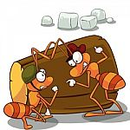
What are we going to learn today?
The top five invasive ant pests.
The problems they cause to our people, our agriculture and our natural environment.
Where these ants come from and how they arrive in our country.
What can you do to stop them.
Image courtesy of TAW4 at FreeDigitalPhotos.net
Notes:
Credits: Image from Image courtesy of TAW4 at FreeDigitalPhotos.net retrieved from http://www.freedigitalphotos.net/images/agree-terms.php?id=100300418

Slide 3
Ants? What are they?
Ants are living things. They need air, food and water.
Ants are insects.
They have 3 body parts and 6 legs.
They are in the same family as wasps and bees.
The queen ant can lay thousands of eggs a day.
Notes:
Credits: © Phil Lester

Slide 4
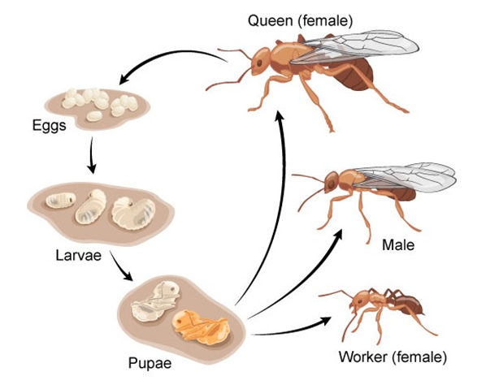
Ant life cycle
Ants go through a number of different stages from egg to adult. They have a 4 stage life-cycle just like the butterfly!
One or more queens lay eggs that develop into new workers, queens and males.
Notes:
Ants go through the same life stages as butterflies. Eggs hatch into larvae, which moult and grow until they eventually pupate. Adult ants emerge from the pupae. Ants are social insects. This means there is a worker caste that forage, tend the young and protect the nest, and one or more queens which lay eggs that develop into new workers, queens and males. Males, mate with he queens then die – they do not perform any other function. Only queens and males can fly, and only for very short distances. No ant is capable of flying the distances between Pacific Islands.
Credits: life cycle image © Arizona Board of Regents / ASU Ask A Biologist (https://askabiologist.asu.edu/individual-life-cycle); photograph © Meghan Cooling

Slide 5
What is an invasive ant?
An ant that is introduced outside its home range and that damages the natural environment of its new home.
The picture shows red imported fire ants travelling over floodwaters on an uprooted tree.
Notes:
An ant outside its home range is considered invasive when it damages the human or natural environment. Some ants only become invasive when they reach high numbers. The photo shows fire ants covering a myrtle shrub.
Credits: © Matthew Hinton (http://photos.nola.com/nolacom_photo_essays/2011/09/photographers_lens_tropical_st.html#photo-9971883) (sent an email Nov 02/2016 asking permission, awaiting response)

Slide 6
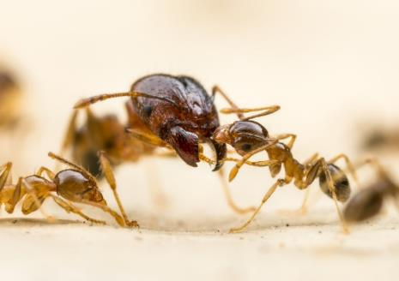
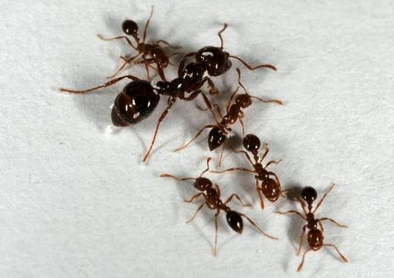
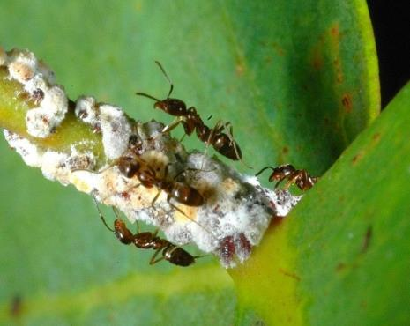
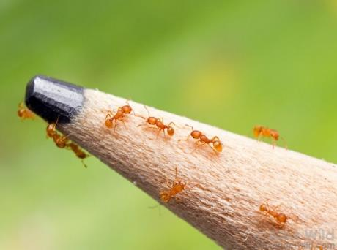
The five WORST invasive ANTS in the Pacific
African big-headed ant
Red imported fire ant
Little fire ant
Argentine ant
Yellow crazy ant
You can’t tell just by looking at these five ant species that they cause worse problems than any other ants
Notes:
These are the top five worst invasive ants in the Pacific. Looking at these pictures it is difficult to see what makes them any different or any worse from other ants. The next slide uses icons to illustrate the problems each causes. Using the icon sheets, work with the class to discuss the effect each of the five ants has on people, agriculture and the environment.
Credits: centre, bottom left and top right © Phil Lester; top left and bottom right © Alex Wild

Slide 7
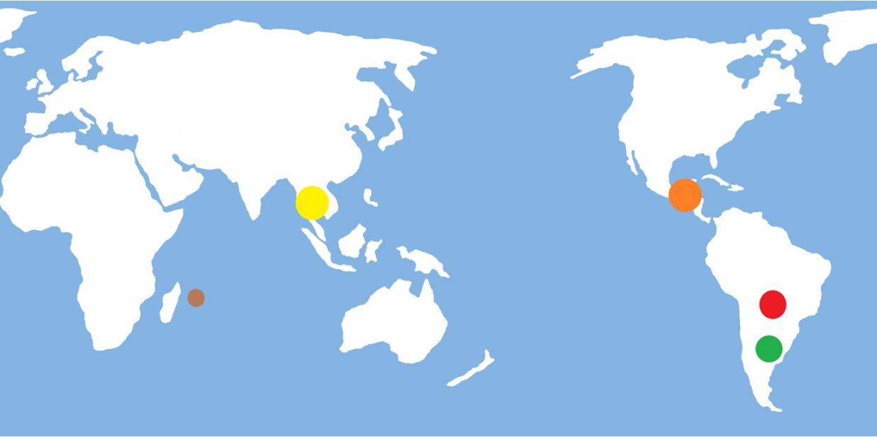
Where did the ants come from?
? Yellow crazy ant
Little fire ant
African big headed ant
Red imported fire ant
Argentine ant
Notes:
It is uncertain exactly where the top five invasive ant species originally came from. Scientific evidence suggests that, little fire ants came from Central America, red imported fire ants and Argentine ants came from South America, yellow crazy ants came from Asia and African big-headed ants came from Africa.
Credits: World map from free clipart site www.clker.com

Slide 8
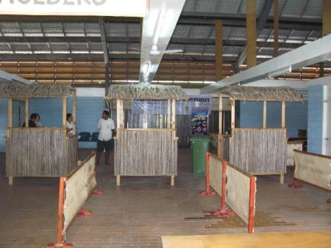

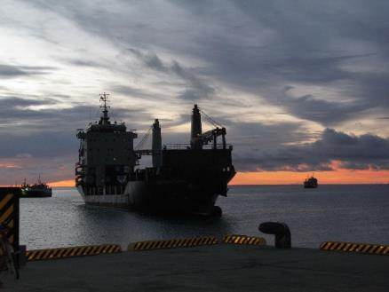
Where might we find invasive ants?
How they come into the country:
Ports
On ships
Airports
Unloading areas
Storage areas
Image of plane courtesy of satit_srihin at FreeDigitalPhotos.net
Notes:
They may be hiding almost anywhere.
Whole nests can be hidden in soil around potted plants or in a single coconut or macadamia nut!
What other places might they be hiding?
When cargo, especially sea containers, vehicles and appliances are brought in to the country invasive ants that have been hitching a ride on them will go in search of food or a new place to nest. Placing food lures in plastic pots at regular intervals around the port or other entry or storage area will attract any newly arrived ants and allow them to be trapped and identified.
Credits: © Allan Burne – Pacific Biosecurity, Image of plane courtesy of satit_srihin at FreeDigitalPhotos.net

Slide 9
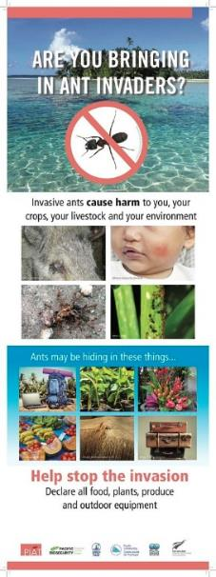
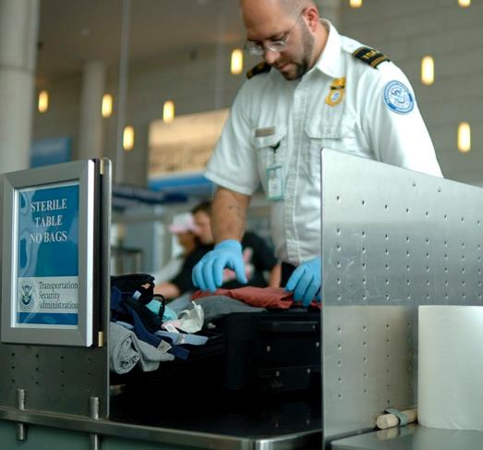
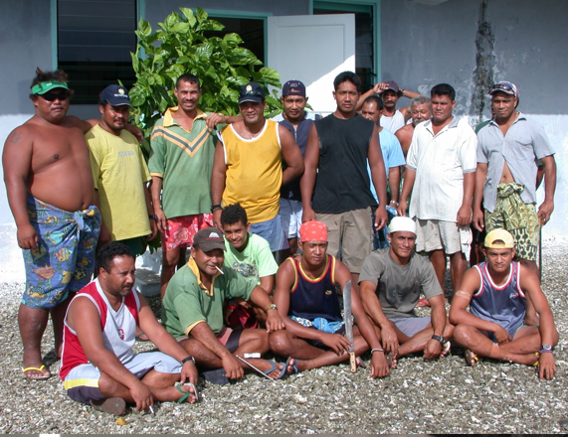
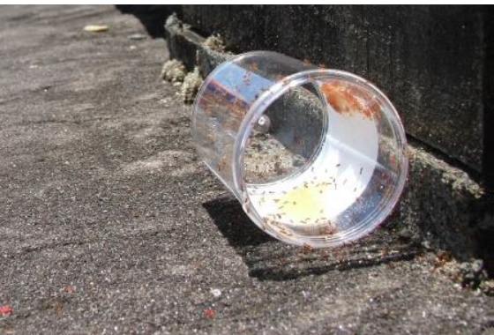
How do we find ants when they arrive?
Biosecurity!
Biosecurity officers check incoming goods at airports and ports to detect invasive ants
Make communities aware of the problems ants can cause. Community members can be on the lookout for invasive ants
Lures (sugar, peanut butter) placed in ports attract ants
Notes:
When the pathways that ants use to enter a country have been identified (e.g. fresh produce, vehicles etc.) it is important to check those goods for ants at the border. When there are lots of things coming in it can be too much work to check them all. As some items are stored at the ports where they arrived it makes sense to monitor those ports for newly arrived ants. Put down attractive lures at regular intervals to attract and trap any ants. The samples can then be collected and identified. There is always a chance that something might escape – it only takes one queen ant to start an invasion! If the community knows what to look for , they can report any new or problem ants they encounter. Posters are a great way to let the community know what you are looking for and who to call if they find it.
Credits (clockwise starting at top left): © Carolina K. Smith MD / Shutterstock.com

Slide 10
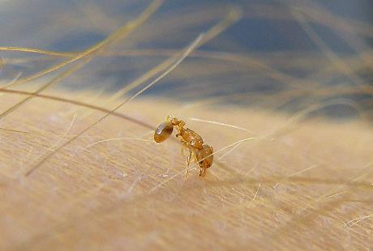
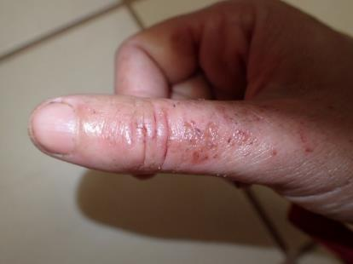
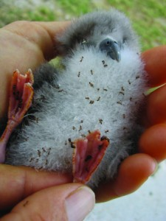
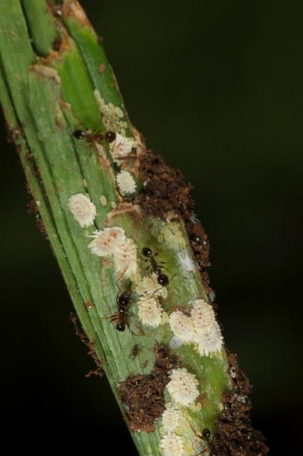

Why are some ants bad?
Clockwise from left: A little fire ant biting; skin rash caused by yellow crazy ants; Sea bird chick covered by African big-headed ants; a child stung on the cheek by a fire ant; ants ‘farm’ scale insects, which damage crops.
Notes:
When invasive ants reach high abundance, they can be a major nuisance in three ways: 1. they farm scale insects, aphids and other honeydew producing bugs, which damage crop plants, reduce yields and spread crop diseases. 2. They can kill or injure local wildlife including birds, crabs, lizards, insects and can make it difficult for stock animals like pigs and chickens to feed. 3. Many invasive ants sting or bite when disturbed. Stings can form blisters and become infected. Sometimes the ants can grow to such high numbers that people cannot eat, work or sleep because there are always ants crawling all over them.
Additional Information:
Damage to agriculture and crops. Invasive ants don’t directly damage crops, but they “farm” sap sucking insects such as aphids, scale insects and mealy bugs that do. These sap sucking insects directly damage the plants and spread plant diseases. The ants protect the sap sucking pests from predators, which allows the pests to increase their numbers. In return the ants collect the sugary honeydew that the sap suckers excrete. The ants also make it difficult for stock animals such as pigs and chickens to eat or sleep and the ants may also kill and eat newly hatched chicks.
Damage to the environment. Ants are hungry predators. When they are in large numbers invasive ants kill other insects, birds, crabs, lizards and other animals. Some of these animals perform important actions for the whole ecosystem. For example, on Christmas Island crabs remove seedlings of understorey vegetation. When yellow crazy ants killed all the crabs, the understorey vegetation went wild. The large numbers of understorey plants shaded out all the canopy seedlings. This meant that there would be no new canopy trees to replace old ones that fell and that the entire ecosystem would change. As some birds and other animals depend on these canopy trees for food and shelter their numbers decline. This in turn affects the birds and other animals that preyed on them. So, ants killing the crabs had an effect on the entire ecosystem. Some Pacific ecosystems are not well understood, so it is uncertain what large scale effects invasive ants may have on them.
Invasive ants can cause humans great discomfort. Some species of ants bite, while others sting or spray acid when they are disturbed. In large numbers the ants make it difficult for people to eat, gather food, work or sleep as they crawl all over them day and night. Ask the students to share any stories they may have about ants in their homes, on their family’s crops or that they might have seen in the bush.
Credits clockwise from left © Plegadis, Wikipedia, © Meghan Cooling, © Sheldon Plentovich, © Shutterstock / Panya Kuanun, MISC website, © Phil Lester

Slide 11
Are all ants invasive?
No!
Only some introduced ants cause problems.
Some ants are only bad in great numbers.
Most ants do good things for the environment. They cycle nutrients in soil and eat the larvae of household pests like flies and cockroaches.
The ant in the picture is called a trap jaw ant. It has been introduced into the Pacific but does not cause problems (although it can bite!)
Notes:
Ants perform a number of tasks that are good for the environment. Perhaps most importantly they assist in the breakdown of organic materials and nutrient cycling. Even ants that are introduced outside of their natural range can benefit the environment.
The ant in the picture is Odontomachus similimus. It is one of the biggest introduced ants in the Pacific and while it can give a nasty bite and has a painful sting, it is not aggressive. It is a slow moving solitary hunter that rarely causes people ant bother.
Some ants only become a problem when they reach high numbers. Others cause problems because they sting or spray acid.
It is important that students understand that not all ants are a problem. Generally, ants are beneficial to the environment acting as decomposers and soil enrichers. Some ants (such as yellow crazy ants) are only a problem in large numbers.
Credits: © Eli Sarnat, Share Alike CC BY-SA Licence

Slide 12
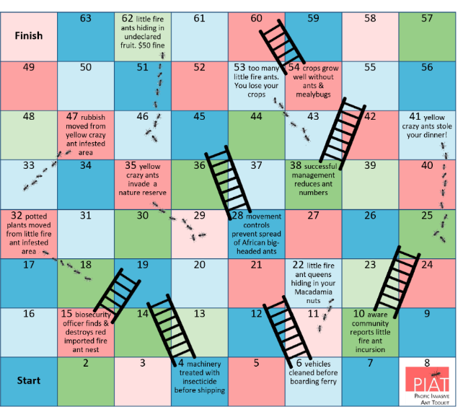
Activity Time! We are going to play Ants and Ladders!
Notes:
Credits:
ant & ladders was created by Allan Burne & Monica Gruber of Pacific Biosecurity for the PIAT on behalf on New Zealand Ministry of Foreign Affairs and Trade

Slide 13
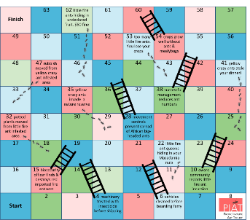
Rules
Each player puts their counter on the space that says ‘Start'.
Take it in turns to roll the dice. Move your counter forward the number of spaces shown on the dice.
If your counter lands at the bottom of a ladder, you can move up to the top of the ladder after you have read the information to your friends.
If your counter lands on an ant trail, you must slide down to the bottom of the trail after you have read the information to your friends.
The first player to get to the space that says ‘Finish' is the winner.

Slide 14
Ladders – positive actions (English)
54 Items of machinery have lots of small spaces that ants can nest in. Machinery should be treated with insecticides, or at least cleaned well before being moved between islands.
38 There are ways to reduce numbers of ants so that they don’t have effects on people, agriculture and wildlife.
28 Biosecurity officers are the first line of protection against invasive ants. Help them do their job by reporting any ants that you think are a problem.
22 Little fire ants are so small that a whole colony can nest in a Macadamia nut. Other ants, such as yellow crazy ants, love nesting in rotting coconuts.
15 Movement controls are the first step in preventing invasive ants spreading. It is very important to pay attention to these controls and not move risk items (plants, rubbish, machinery), without first having them approved.
10 A little awareness can help stop ant problems. Report any ants that you think are a problem to biosecurity officers.
6 Vehicles have lots of small spaces that ants can nest in. They should be checked and cleaned before being moved between islands.
4 Ants ‘farm’ plant pests such as mealybugs and scale insects, which can reduce plant growth. Plants grow better without these pests.
Notes:
Credits: Image from Image courtesy of TAW4 at FreeDigitalPhotos.net

Slide 15
Ants – negative actions (English)
62 When travelling it is important to declare high risk items. Not declaring biosecurity risk items (such as fresh fruit) can result in a fine in many nations in the Pacific.
53 Little fire ants have a nasty sting which makes it difficult to harvest crops. Some people in French Polynesia have even abandoned their land because of little fire ants.
47 Ants love nesting in rubbish piles (and piles of decaying coconuts and plants). Moving these items provides a way of ants invading new places.
41 In Tokelau yellow crazy ants invaded homes and even tried to take food off people’s plates before they had a chance to eat.
35 Wildlife such as lizards, land birds and sea birds and crabs are at great risk from ants. They ants can kill the animals directly or make them leave the area.
32 A very important ‘pathway’ for little fire ants in Hawaii is potted plants from nurseries. These ants can spread very easily this way. Make sure to get plants from areas not infested with ants.
22 Little fire ants are so small that a whole colony can nest in a Macadamia nut. Other ants, such as yellow crazy ants, love nesting in rotting coconuts.
Notes:
Credits: Image from Image courtesy of TAW4 at FreeDigitalPhotos.net

Slide 16
What we have learnt today
Ants are insects. They have 3 body parts and 6 legs.
An ant is invasive when it has left its home range and damages the natural environment of its new home.
Not all ants are invasive. Most do good things for the environment like helping decomposition.
Some ants are bad because they can cause harm to our farms, human and our environment.
Ants enter the country in many ways. Everyone must work together for biosecurity.
Image courtesy of TAW4 at FreeDigitalPhotos.net
Notes:
Credits: Image from Image courtesy of TAW4 at FreeDigitalPhotos.net

Slide 17

See you next time!
Image courtesy of arztsamui at FreeDigitalPhotos.net
Notes:
Credits: Image from Image courtesy of arztsamui at FreeDigitalPhotos.net

